Slide 1

Ho Chi Minh City University of Transport
Image Processing and Computer Vision
Segmentation & Blending
Tran Le Anh
anhtl@ut.edu.vn
04-2025

Slide 2
Segmentation
Blending

Slide 3
Segmentation
Blending

Slide 4
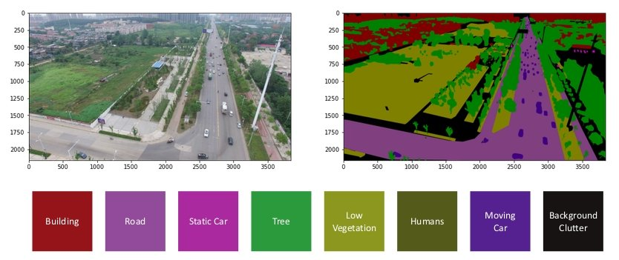
Segmentation
Concept
- Image segmentation involves dividing an image into different regions or segments based on certain characteristics, like pixel intensity or color.
- The goal is to identify meaningful regions to represent objects or features, making the image easier to analyze.
Ref: https://viso.ai/deep-learning/image-segmentation-using-deep-learning/

Slide 5
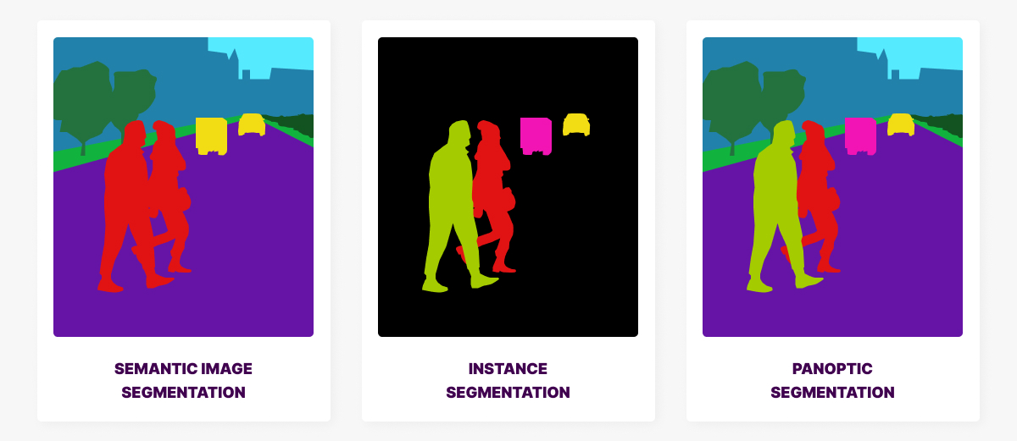
Segmentation
Types
- Semantic segmentation: Assigns a class label to each pixel, grouping pixels belonging to the same object.
- Instance segmentation: Identifies individual instances (objects) within a class and segments them.
- Panoptic segmentation: Combines semantic and instance segmentation.
Ref: https://mindy-support.com/news-post/what-is-image-segmentation-the-basics-and-key-techniques/

Slide 6
Segmentation
Applications
- Medical Imaging
- Autonomous Driving
- Remote Sensing

Slide 7
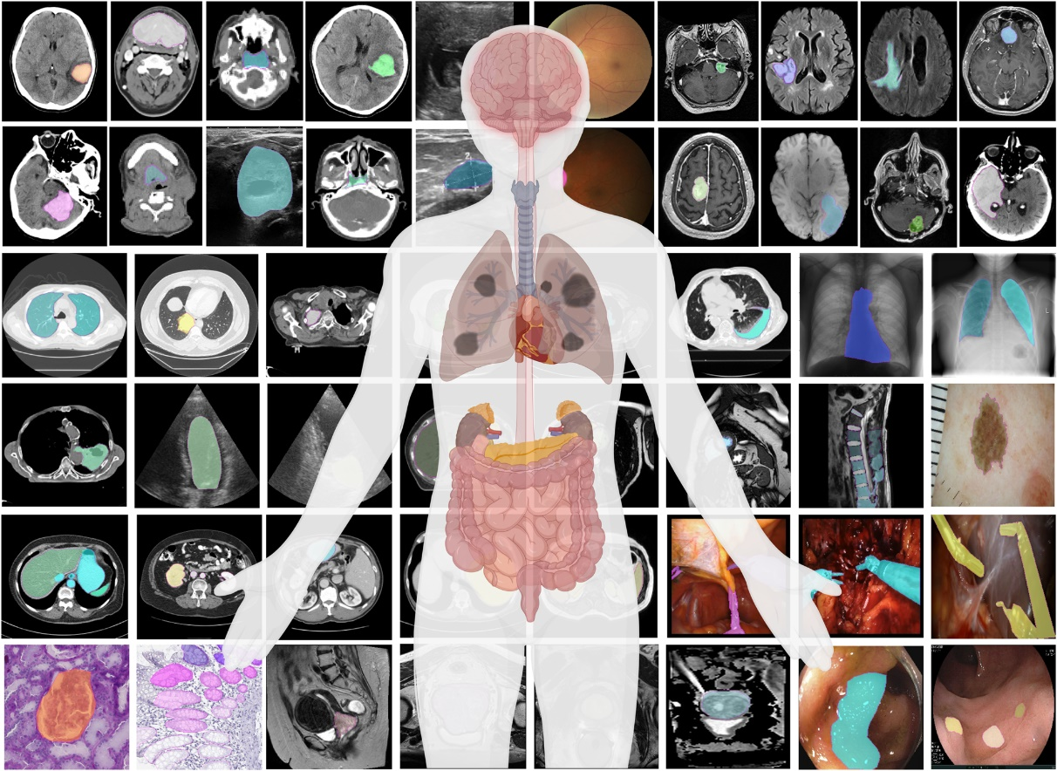
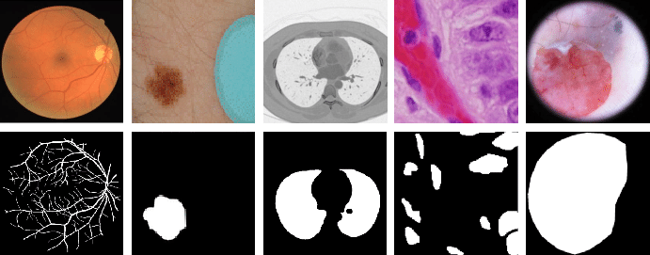
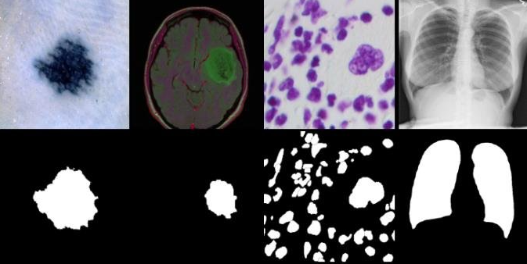
Segmentation
Medical Imaging
- To isolate and analyze specific regions of interest (ROIs) within medical images, aiding in various clinical applications.
Ref: Segment anything in medical images

Slide 8
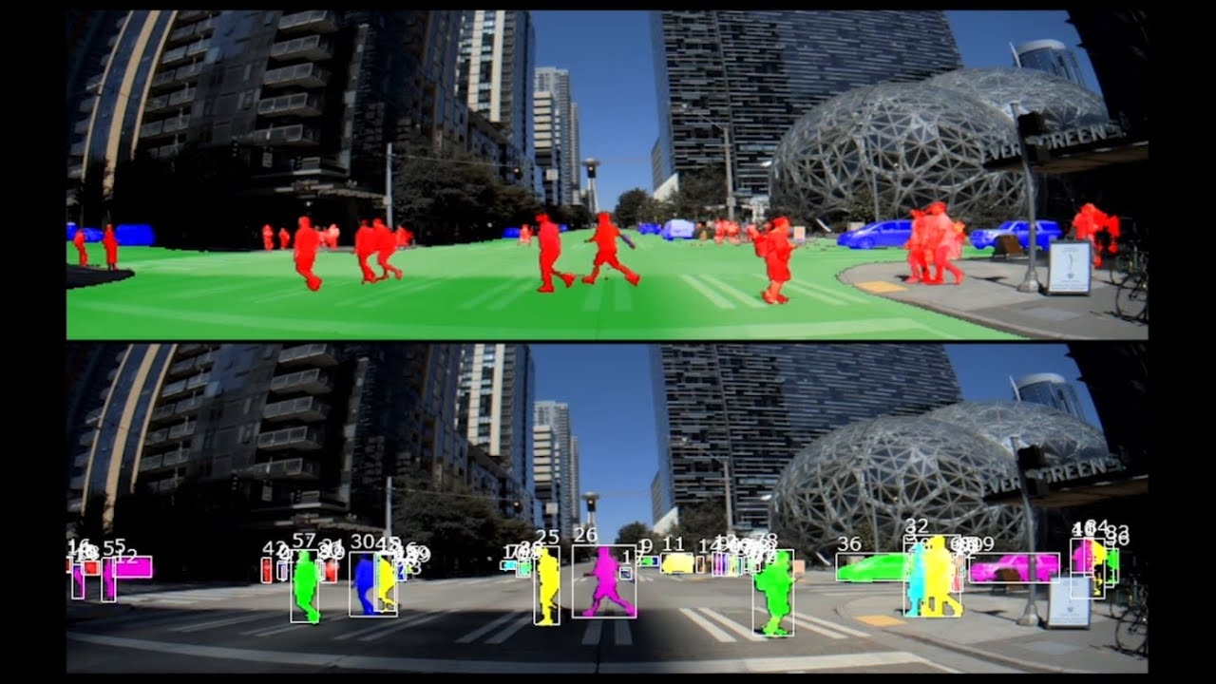
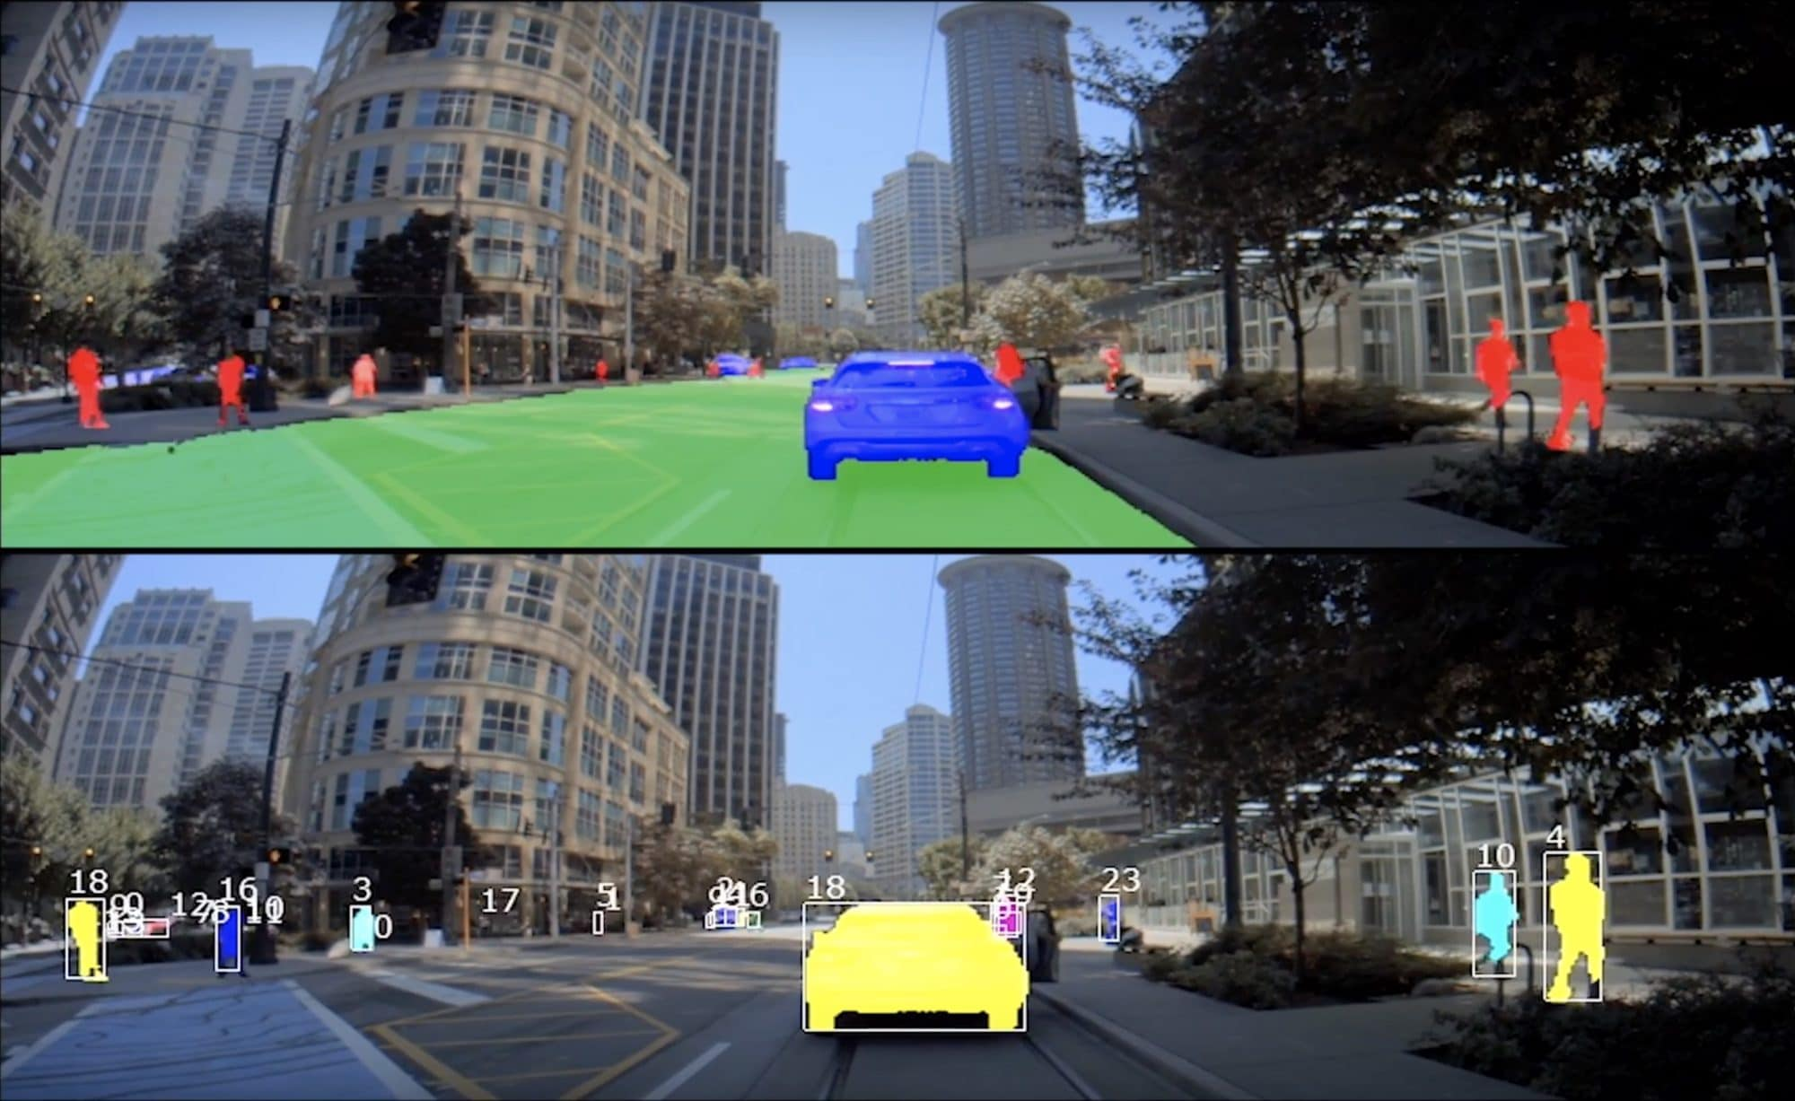
Segmentation
Autonomous Driving
- To enable vehicles to understand their surroundings, allowing for the precise labeling of each pixel in an image, identifying objects like cars, pedestrians, roads, and traffic lights.
Ref: https://blogs.nvidia.com/blog/drive-labs-panoptic-segmentation/

Slide 9
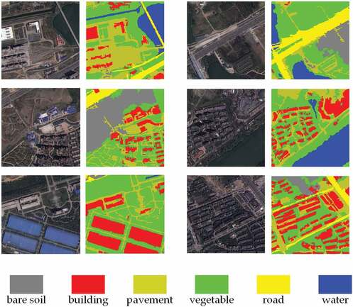
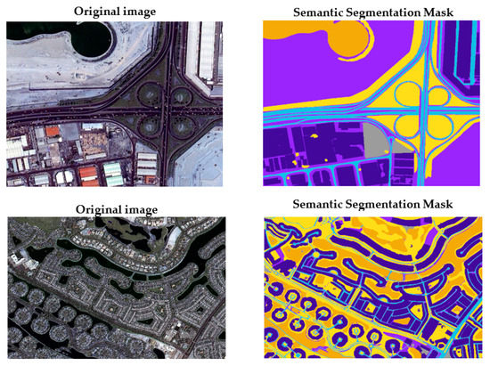
Segmentation
Remote Sensing
- To extract urban features (roads, buildings, water bodies) from satellite images, identifying land cover types, and monitoring changes in the Earth's surface.
Ref: https://www.tandfonline.com/doi/full/10.1080/10095020.2021.2017237

Slide 10
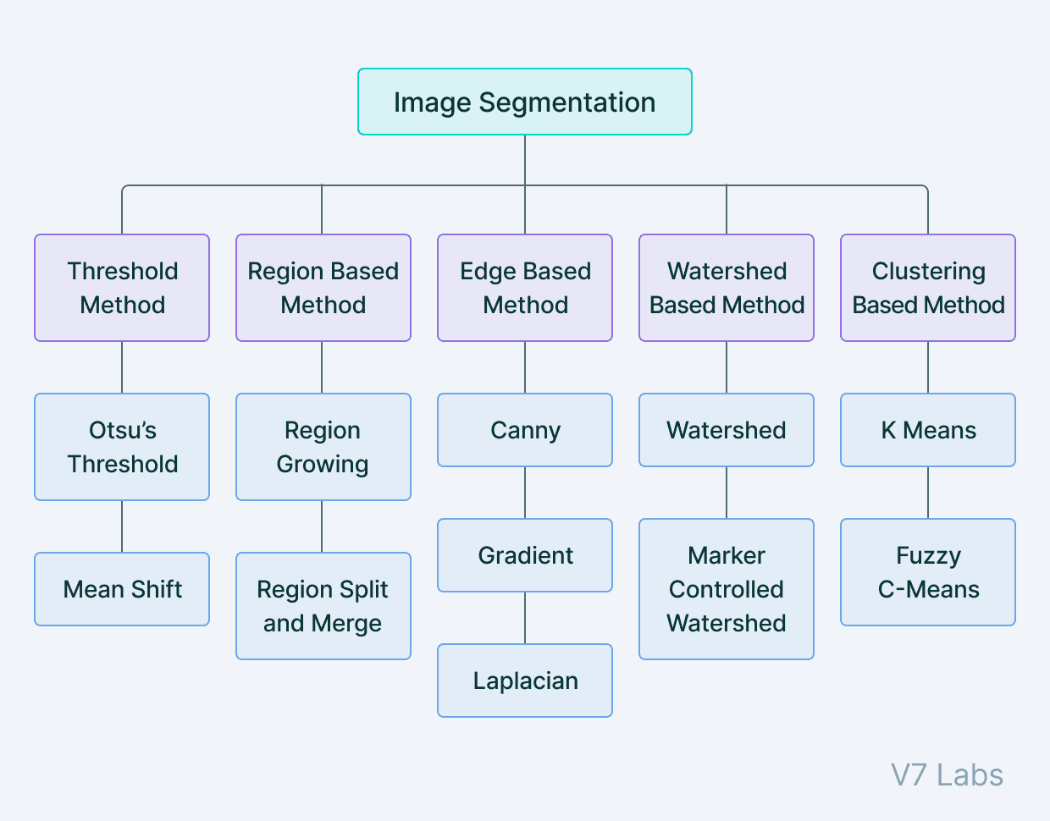
Segmentation
Techniques
- Thresholding
- Region growing
- Clustering
- Deep learning
Ref: https://www.v7labs.com/blog/image-segmentation-guide

Slide 11
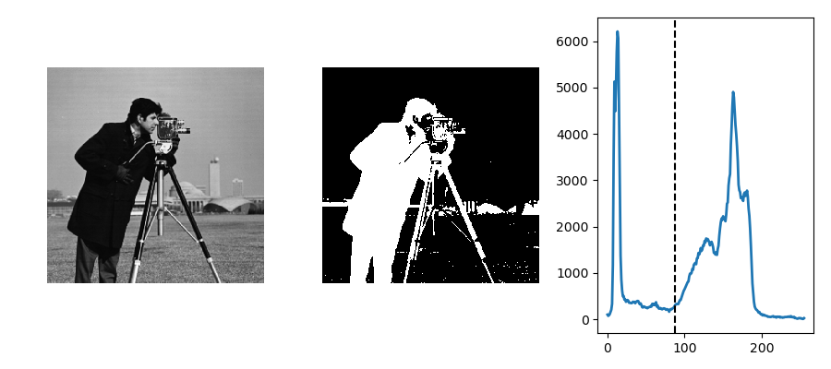
Segmentation
Thresholding
- Thresholding methods create binary images, classifying pixels based on whether their intensity is above or below a given “threshold value”.
Ref: https://scipy-lectures.org/packages/scikit-image/auto_examples/plot_threshold.html

Slide 12
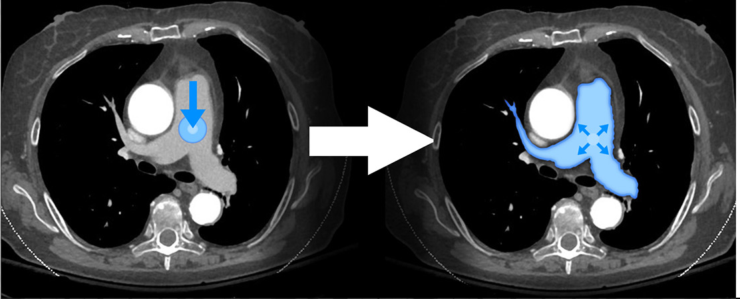
Segmentation
Region Growing
- Region growing starts by selecting a seed pixel or region and gradually expands this seed by incorporating neighboring pixels or regions that meet specific similarity conditions.
Ref: https://3dqlab.stanford.edu/region-growing/

Slide 13
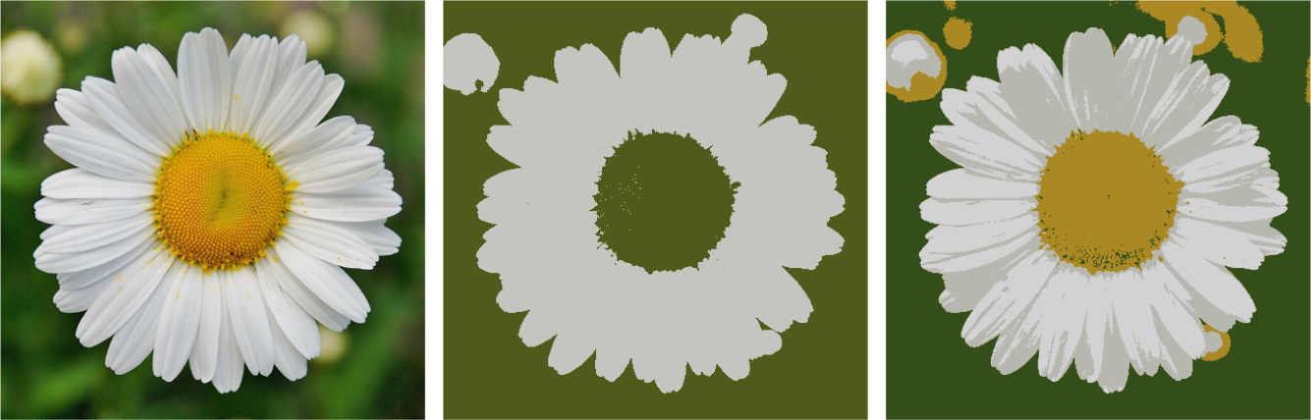
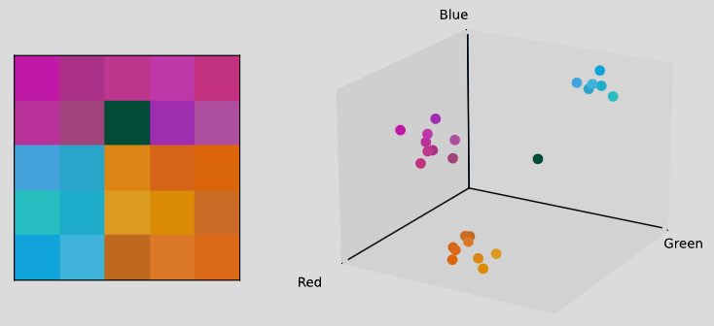
Segmentation
Clustering
- Clustering-based image segmentation relies on clustering algorithms like K-means or Mean Shift to identify distinct areas with similar attributes.
Ref: https://vincmazet.github.io/bip/segmentation/clustering.html

Slide 14
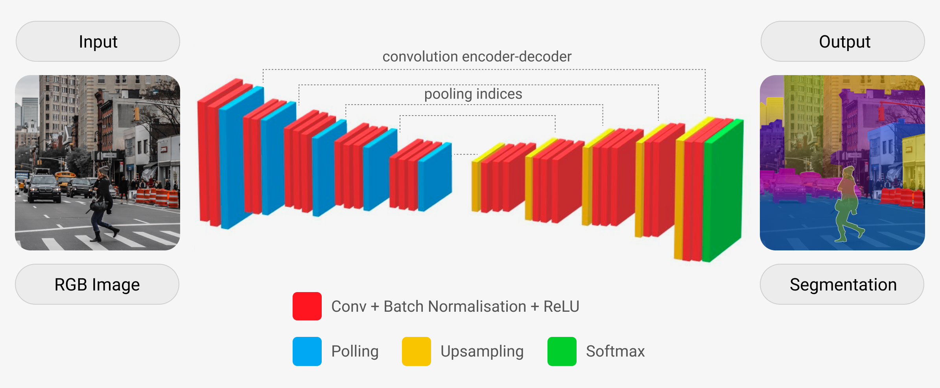
Segmentation
Deep Learning
- Deep learning-based image segmentation uses neural networks, often Convolutional Neural Networks (CNNs), to learn hierarchical features from large datasets to predict pixel-level labels.
Ref: https://mindy-support.com/news-post/complete-guide-to-semantic-segmentation/

Slide 15
Segmentation
Blending

Slide 16
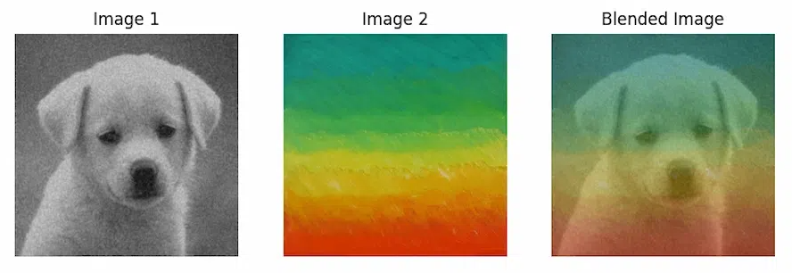
Blending
Concept
- Image blending combines two or more images into a single, seamless image.
- The goal is to create a natural-looking composite image, often by overlapping regions and adjusting transparency.
Ref: https://www.geeksforgeeks.org/image-blending-using-opencv/

Slide 17
Blending
Applications
- Panorama Stitching
- Image Composition and Editing
- Augmented Reality (AR)

Slide 18
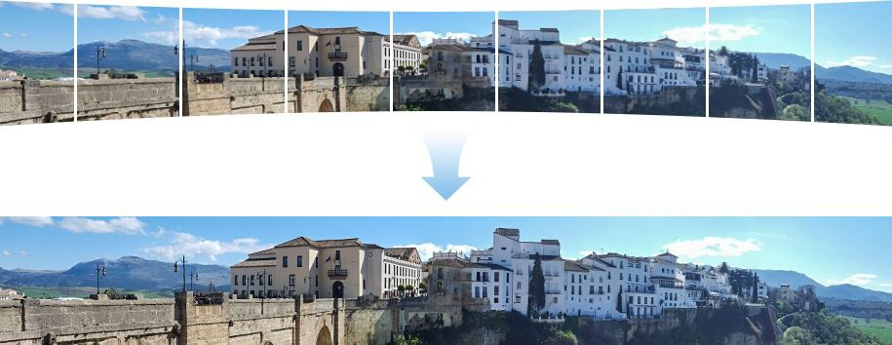
Blending
Panorama Stitching
- Panorama stitching is the process of combining multiple overlapping images to create a larger, seamless panoramic image.
Ref: https://www.baeldung.com/cs/image-stitching

Slide 19
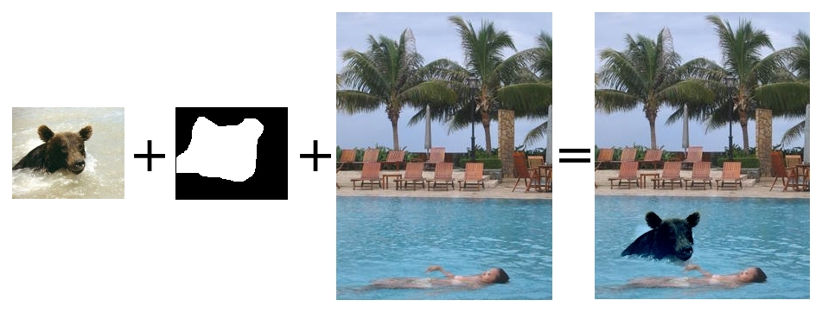
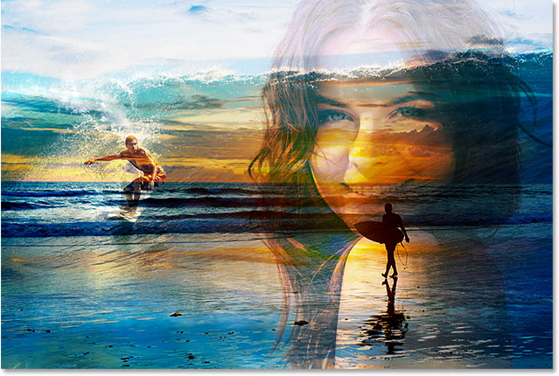
Blending
Image Composition/Editing
- Image blending is used in photo editing and image composition tools to combine different images, adjust color, and create visually appealing compositions.
Ref: https://cs.brown.edu/courses/cs129/asgn/proj3_poisson/index.html

Slide 20
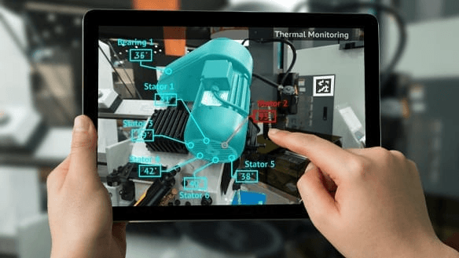
Blending
Augmented Reality (AR)
- Augmented Reality (AR) utilizes image blending to overlay digital content onto the real world.
Ref: https://nxtinteractive.ae/blog/how-augmented-reality-%28ar%29-works-a-deep-dive

Slide 21
Blending
Techniques
- Weight-based Blending
- Poisson Image Blending
- Deep Image Blending

Slide 22
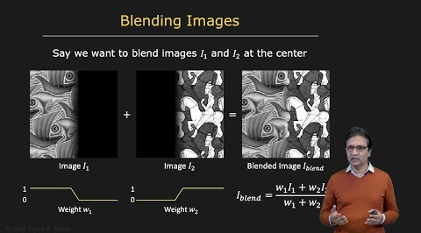
Blending
Weight-based Blending
- Involves assigning weights to different regions of the input images and combining them proportionally.
Ref: https://www.youtube.com/watch?v=D9rAOAL12SY

Slide 23
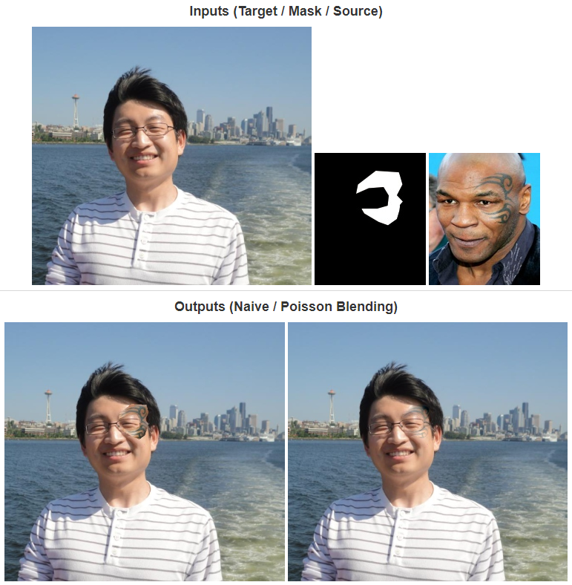
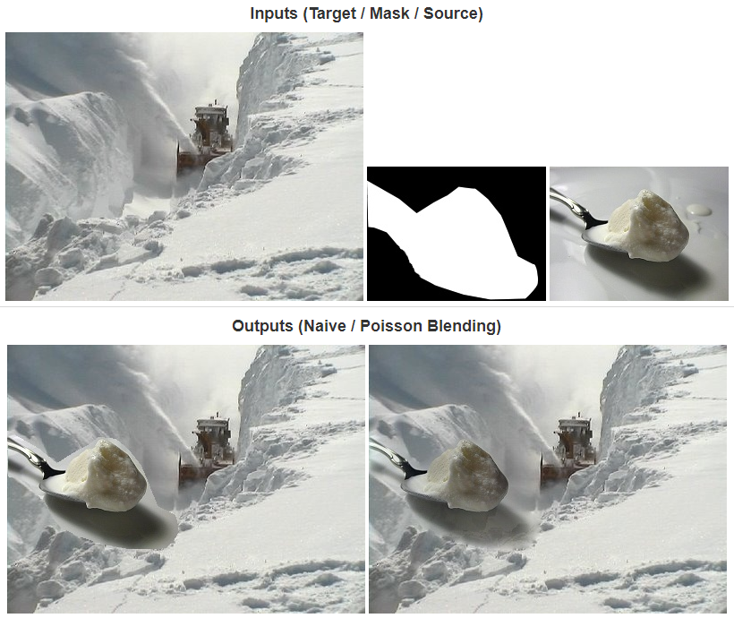
Blending
Poisson Image Blending
- Combines two images by focusing on gradients (changes in intensity) rather than the pixel values.
Ref: https://cs.brown.edu/courses/cs129/results/proj2/taox/

Slide 24
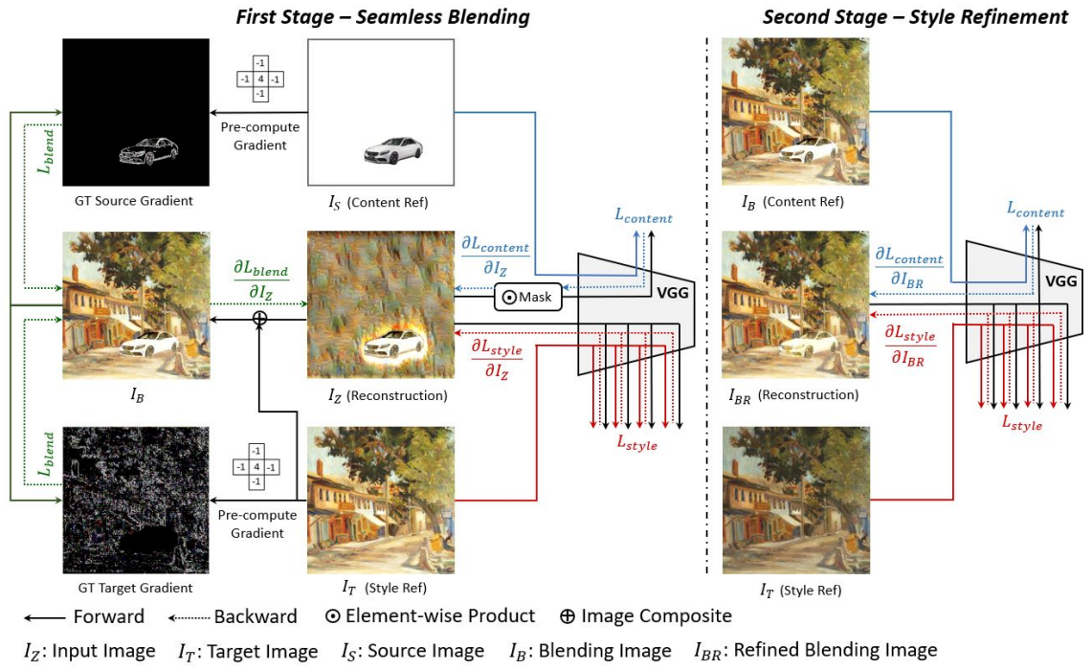
Blending
Deep Image Blending
- Leverages deep learning to generate realistic and visually appealing blending results.
Ref: Deep Image Blending

Slide 25
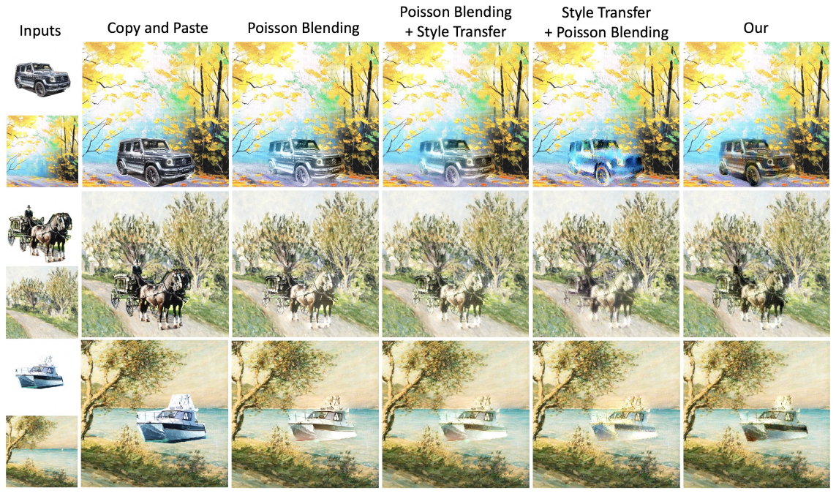
Blending
Deep Image Blending
Ref: Deep Image Blending

Slide 26
Segmentation & Blending
Practice
- Segmentation
- Blending

Slide 27
Thank You
anhtl@ut.edu.vn

